Slide 1
Requirements Modeling and UML Diagrams
COMP6100001 - Software engineering
Session 07
Maulin Nasari S.T., M.Kom.

Slide 2
Session 07 – Requirements Modeling and UML Diagrams
Learning objectives
At the end of this session, students will be expected to be able to:
Understand the Purpose and Importance of System Modeling in Software Design
Describe Key UML Diagram Types and Their Components
Apply UML to Model Software Systems

Slide 3
Session 07 – Requirements Modeling and UML Diagrams
Content outline
• Requirements Analysis
• Scenario-Based Modeling
• Class-Based Modeling
• Functional Modeling
• Behavioral Modeling

Slide 4
Introduction to Requirements Modeling
Requirements modeling:
Represents requirements using text and diagrams
Makes requirements easier to:
  Understand
  Review
  Validate
Why it matters:
Enables early stakeholder feedback
Helps detect errors before design
Forms the basis for software design

Slide 5
How Requirements Modeling Is Done
Who builds the models:
Software engineers / analysts
Based on elicited stakeholder requirements
Modeling perspectives:
Scenario-based modeling
Class-based modeling
Behavioral modeling
Work products:
Usage scenarios (use cases)
UML diagrams
Quality check:
Correctness
Completeness
Consistency

Slide 6
Requirements Analysis
What Is Requirements Analysis?
Defines the software’s operational characteristics
Identifies:
  Interfaces with other system elements
  Constraints the software must satisfy
Elaborates requirements from:
  Inception
  Elicitation
  Negotiation

Slide 7
Requirements Analysis
Purpose of Requirements Analysis
Requirements analysis aims to:
Describe what the customer needs
Provide a basis for software design
Define requirements that can be validated
Outcome:
Clear input for architecture, interface, and component design
A reference for assessing quality after implementation

Slide 8
Requirements Analysis
Requirements Analysis Philosophy
“Analysis asks what, not how”
Focus on:
What interactions occur?
What data is manipulated?
What functions are required?
What behaviors are expected?
What constraints apply?
Not the focus:
How the system is implemented
Architectural or technical decisions

Slide 9
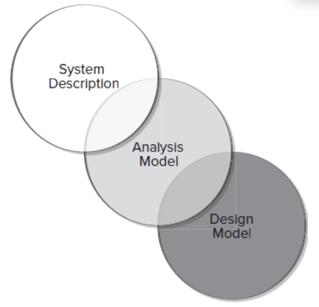
Requirements Analysis
Analysis Model as a Bridge
The analysis model:
Bridges system description and software design
Connects business needs to technical solutions
Ensures traceability from requirements to design
Important note:
Analysis and design may overlap
Clear separation is not always possible

Slide 10
Requirements Analysis
Requirements Modeling Principle
Over time, many modeling methods have emerged, but they share common principles.
These principles guide:
How we analyze problems
How we build useful models
How we avoid premature design

Slide 11
Requirements Analysis
Requirements Modeling Principle
Principle 1: Represent the Information Domain
Identify:
  Data entering the system
  Data leaving the system
  Data stored permanently
Understand what information the system manages
Principle 2: Define Software Functions
Identify functions that:
  Provide value to users
  Support internal processing
Functions may:
  Transform data
  Control system behavior
  Principle 3: Represent Software Behavior
  Software reacts to external events
  Behavior is driven by:
    User input
    External systems
    Network or sensor data
  Different events → different system responses

Slide 12
Requirements Analysis
Requirements Modeling Principle
Principle 4: Partition the Problem
Break complex problems into smaller parts
Use layered or hierarchical models
Apply separation of concerns
Principle 5: Move from Essence to Detail
Start with what the user needs
Avoid implementation decisions early
Delay technical choices until design

Slide 13
Requirements Analysis
Requirements Modeling Principle
Why These Principles Matter
Applying these principles helps engineers:
  Understand complex problems
  Communicate clearly with stakeholders
  Create models that support good design

Slide 14
Requirements Analysis
Types of Requirements Models
Requirements analysis produces one or more models:
Scenario-based models: User interactions and usage
Class-based models: Objects, attributes, operations
Behavioral models: System reactions to events
Data models: Information domain
Flow-oriented models: Functional transformations

Slide 15
SCENARIO-BASED MODELING
Why scenario-based modeling?
User satisfaction is a key measure of system success
Understanding how users interact with a system helps:
  Clarify requirements
  Reduce misunderstanding
  Build meaningful analysis and design models
How it is modeled (UML):
Use case diagrams
Activity diagrams
Sequence diagrams
Scenario-based modeling starts by describing how the system is used

Slide 16
SCENARIO-BASED MODELING
Actors and User Profiles
Actors
Represent roles that interact with the system
Can be:
  Human users
  External systems
  Hardware devices
One physical person may play multiple actor roles
User Profiles
Extend models for:
  Different platforms (e.g., web vs mobile)
  Different user viewpoints
Example:
  System administrator vs end user
Actors describe who interacts with the system, not how it is implemented

Slide 17
SCENARIO-BASED MODELING
Creating Use Cases
From user stories to use cases
User stories: informal, stakeholder language
Use cases: precise, structured descriptions
Use case definition
A use case is a “contract for behavior”
Describes how an actor uses the system to achieve a goal
Captures interactions between:
  Actor
  System
Key questions when writing use cases
What should be written?
How much detail is needed?
How should it be organized?

Slide 18
SCENARIO-BASED MODELING
Where Use Cases Come From
Use cases are derived from:
Inception and elicitation activities
Stakeholder discussions
Defined system goals
Identified functional requirements
How to start
Choose an actor
List the activities the actor performs
Focus on what the system does, not how

Slide 19
Case Study SCENARIO-BASED MODELING
Developing Another Preliminary Use Case: Safehome
The scene: A meeting room, during the second requirements gathering meeting.
The players: Jamie Lazar, software team member; Ed Robbins, software team member; Doug Miller, software engineering manager; three members of marketing; a product engineering representative; and a facilitator.
The conversation:
Facilitator: It’s time that we begin talking about the SafeHome surveillance function. Let’s develop a user scenario for access to the surveillance function.
Jamie: Who plays the role of the actor on this?
Facilitator: I think Meredith (a marketing person) has been working on that functionality. Why don’t you play the role?
Meredith: You want to do it the same way we did it last time, right?
Facilitator: Right . . . same way.
Meredith: Well, obviously the reason for surveillance is to allow the homeowner to check out the house while he or she is away, to record and play back video that is captured . . . that sort of thing.

Slide 20
Case Study SCENARIO-BASED MODELING
Developing Another Preliminary Use Case : Safehome
Ed: Will we use compression to store the video?
Facilitator: Good question, Ed, but let’s postpone implementation issues for now. Meredith?
Meredith: Okay, so basically there are two parts to the surveillance function . . . the first configures the system including laying out a floor plan—we need to have the AR/VR tools to help the homeowner do this—and the second part is the actual surveillance function itself. Since the layout is part of the configuration activity, I’ll focus on the surveillance function.
Facilitator (smiling): Took the words right out of my mouth.
Meredith: Um . . . I want to gain access to the surveillance function either via a mobile device or via the Internet. My feeling is that the Internet access would be more frequently used. Anyway, I want to be able to display camera views on a mobile device or PC and control pan and zoom for a specific camera. I specify the camera by selecting it from the house floor plan. I want to selectively record camera output and replay camera output. I also want to be able to block access to one or more cameras with a specific password. I also want the option of seeing small windows that show views from all cameras and then be able to pick the one I want enlarged.

Slide 21
Case Study SCENARIO-BASED MODELING
Developing Another Preliminary Use Case : Safehome
Jamie: Those are called thumbnail views.
Meredith: Okay, then I want thumbnail views of all the cameras. I also want the interface for the surveillance function to have the same look and feel as all other SafeHome interfaces. I want it to be intuitive, meaning I don’t want to have to read a manual to use it.
Facilitator: Good job. Now, let’s go into this function in a bit more detail . . .

Slide 22
Case Study SCENARIO-BASED MODELING
Documenting Use Case
From Informal to Formal Use Cases
Informal use cases are often sufficient
Formal use cases are needed when:
  The functionality is critical
  The interaction is complex
  Many exceptions exist
Why formalize?
Clarity
Precision
Reviewability

Slide 23
Case Study SCENARIO-BASED MODELING
Documenting Use Case
A formal use case typically includes:
Goal in context: overall purpose
Precondition: what must be true before starting
Trigger: what initiates the use case
Main scenario: normal interaction steps
Exceptions: alternative or error paths
Purpose
Refines informal scenarios into precise behavior descriptions
This structure turns conversations into something engineers can work with.

Slide 24
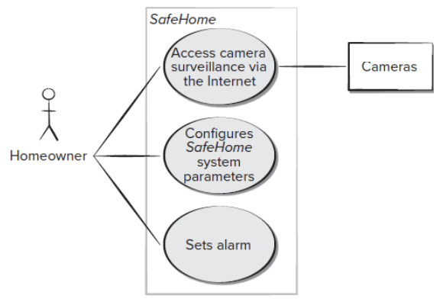
Case Study SCENARIO-BASED MODELING
Use Case Diagram: SafeHome
What the diagram shows
Actor: Homeowner
System boundary: SafeHome
Use cases:
  Access camera surveillance
  Configure system parameters
  Set alarm
What it does NOT show
Internal logic
Sequence of steps
Non-functional requirements
Diagrams summarize what the system offers, not how it works

Slide 25
Class-Based Modeling
Identifying Analysis Classes
How to identify analysis classes
Start from usage scenarios / use cases
Perform a grammatical parse:
  Underline nouns / noun phrases
  Record them in a table
  Note synonyms
Class relevance
Solution space: required to implement the system
Problem space: helps describe the problem only

Slide 26
Class-Based Modeling
Identifying Analysis Classes
Common forms of analysis classes
External entities (people, devices, other systems)
Things in the information domain (reports, displays, signals)
Events or occurrences during system operation
Roles played by users
Organizational units
Places relevant to the system context
Physical or logical structures (sensors, devices, computers)

Slide 27
Class-Based Modeling
Identifying Analysis Classes
Refining Potential Analysis Classes
From nouns to potential classes
All nouns from the narrative are listed as potential classes
Each potential class must be evaluated
Not all potential classes will become analysis classes

Slide 28
Class-Based Modeling
Identifying Analysis Classes
Selection criteria for analysis classes (Coad & Yourdon)
A potential class should be included if it has:
Retained information: The system must remember information about it
Needed services: It has meaningful operations that change its state
Multiple attributes: More than a single simple attribute
Common attributes: Attributes apply to all instances of the class
Common operations: Operations apply consistently to all instances
Essential requirements: External entities that produce or consume essential information

Slide 29
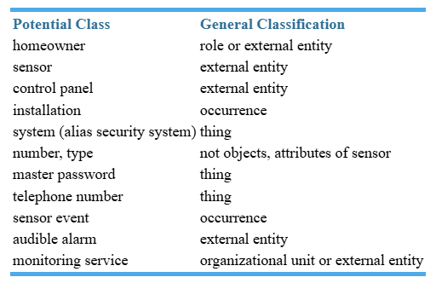
Class-Based Modeling
Identifying Analysis Classes: Case Study SafeHome
Extracting the nouns, we can propose several potential classes:

Slide 30
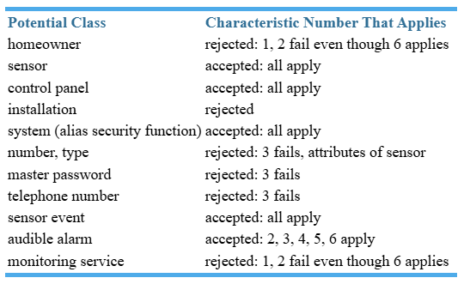
Class-Based Modeling
Identifying Analysis Classes: Evaluating Potential Classes (SafeHome Example)
Each potential class is evaluated against the selection characteristics.
Rejection does not mean “unimportant”
Some rejected classes become:
  Attributes of accepted classes
    number, type → attributes of Sensor
    master password, telephone number → attributes of System
Decisions are not final: Classes may be revised later as understanding improves
Notes:
When defining analysis classes:
The initial list is never complete
Additional classes may be added later
Accept/reject decisions depend on:
Problem description
System scope
Assumptions made during analysis
Different problem statements → different models
Example:
If each homeowner had unique credentials,
Homeowner could become an accepted class
✅ ACCEPTED CLASSES (Become Analysis Classes)
1. Sensor
Status: Accepted (all characteristics apply)
Reason:
Retains information (ID, type, status)
Has operations (detect event, report status)
Has multiple attributes
Attributes and operations apply to all sensors
Essential to system operation
➡ Core domain entity
2. Control Panel
Status: Accepted (all characteristics apply)
Reason:
Retains configuration and status information
Provides services (display status, receive input)
Has multiple attributes (display state, input mode)
Common behavior across instances
Essential interface to the system
➡ Key interaction entity
3. System (Security Function)
Status: Accepted (all characteristics apply)
Reason:
Central object coordinating all behavior
Retains critical configuration data
Provides core services (monitoring, alerting)
Has multiple attributes and operations
Essential for any solution
➡ Core control class
4. Sensor Event
Status: Accepted (all characteristics apply)
Reason:
Represents meaningful occurrences
Retains information (time, type, source)
Triggers system behavior
Common attributes across events
Essential for system response logic
➡ Behavioral domain entity
5. Audible Alarm
Status: Accepted (characteristics 2, 3, 4, 5, 6 apply)
Reason:
Provides services (activate, deactivate)
Has multiple attributes (volume, state)
Operations apply consistently
Essential to system response
➡ Output/control device entity
❌ REJECTED CLASSES (Not Analysis Classes)
6. Homeowner
Status: Rejected (fails characteristics 1 and 2)
Reason:
Does not retain system-managed information
Does not provide system operations
Acts as an external role, not a system object
➡ Modeled as an actor, not a class
(Could change if system manages individual credentials)
7. Installation
Status: Rejected
Reason:
Represents a process, not a persistent object
No retained information across system operation
No reusable attributes or operations
➡ Better represented as an activity, not a class
8. Number, Type
Status: Rejected (fails characteristic 3)
Reason:
Single-value concepts
No independent behavior
Apply only as properties of another class
➡ Become attributes of Sensor
9. Master Password
Status: Rejected (fails characteristic 3)
Reason:
Single data item
No independent operations
Not meaningful as a standalone class
➡ Becomes an attribute of System
10. Telephone Number
Status: Rejected (fails characteristic 3)
Reason:
Simple data element
No behavior
Used only as part of system configuration
➡ Becomes an attribute of System
11. Monitoring Service
Status: Rejected (fails characteristics 1 and 2)
Reason:
External organizational entity
Does not retain system state
Does not provide internal system services
➡ Modeled as an external actor/system, not a class

Slide 31
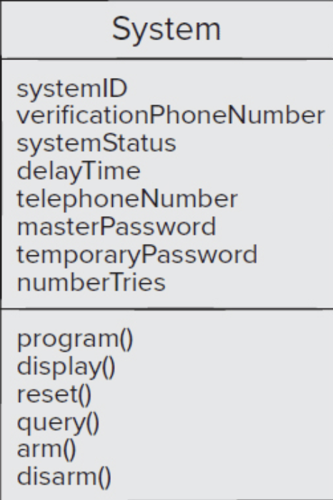
Class-Based Modeling
Defining Class Attributes
What are attributes?
  Attributes describe the state of a class
  They clarify what the class means in the problem
Example: System class (SafeHome)
Composite attributes:
Identification information
  systemId
  verificationPhoneNumber
  systemStatus
Alarm response information
  delayTime
  telephoneNumber
Activation / deactivation information
  masterPassword
  temporaryPassword
  numberTries
Design note: Items associated multiple times (e.g., Sensors) are modeled as separate classes, not attributes

Slide 32
Class-Based Modeling
Defining Class Attributes
What are operations?
Operations define the behavior of a class
They act on:
  Attributes
  Associations with other classes
Common operation categories
Data manipulation (add, delete, update)
Computation
State inquiry
Event monitoring
Example: System class operations
program()
display()
reset()
query()
arm()
disarm()

Slide 33
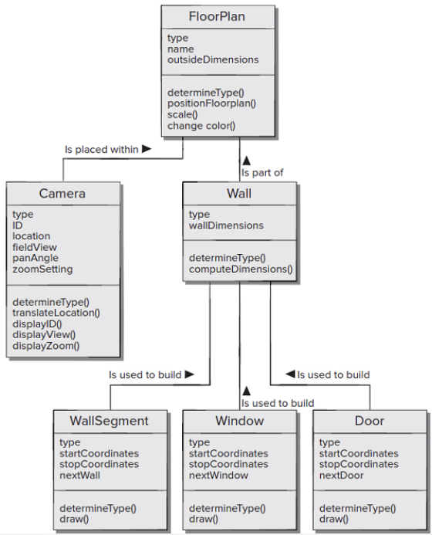
Class-Based Modeling
UML Class Model
Purpose: Represents the structural relationships among classes in the SafeHome floor-plan and camera subsystem.
Key Relationship to Notice
The FloorPlan class is defined by identifying a set of associations between FloorPlan and two other classes, Camera and Wall. The class Wall is associated with three classes that allow a wall to be constructed, WallSegment, Window, and Door.
Design Decisions Reflected in the Model
Physical objects are modeled as classes
Repeated structures are separated into reusable components
Geometry and display behavior are encapsulated in each class

Slide 34
Functional Modeling
What functional modeling addresses
Describes what processing the system performs
Focuses on behavior, not structure
Two levels of functional abstraction
User-observable functionality
    Functions initiated directly by users
    What the user sees as system behavior
    Example: calculating a mortgage payment
Class-level operations
Operations inside analysis classes
Manipulate attributes and support collaboration between classes
Implement user-visible functions internally
Functional modeling connects what users experience with how the system performs it internally.

Slide 35
Functional Modeling
A Procedural View
Procedural view of functionality
Describes how processing flows inside the system
Focuses on steps, decisions, and parallel activities
Independent of implementation details
UML Activity Diagram
Used to represent processing logic graphically
Supplements use cases by showing:
  Flow of actions
  Decision points
  Possible parallel behavior
Analysis-level guideline
Use activity diagrams only when functionality is complex
Avoid over-modeling simple interactions

Slide 36
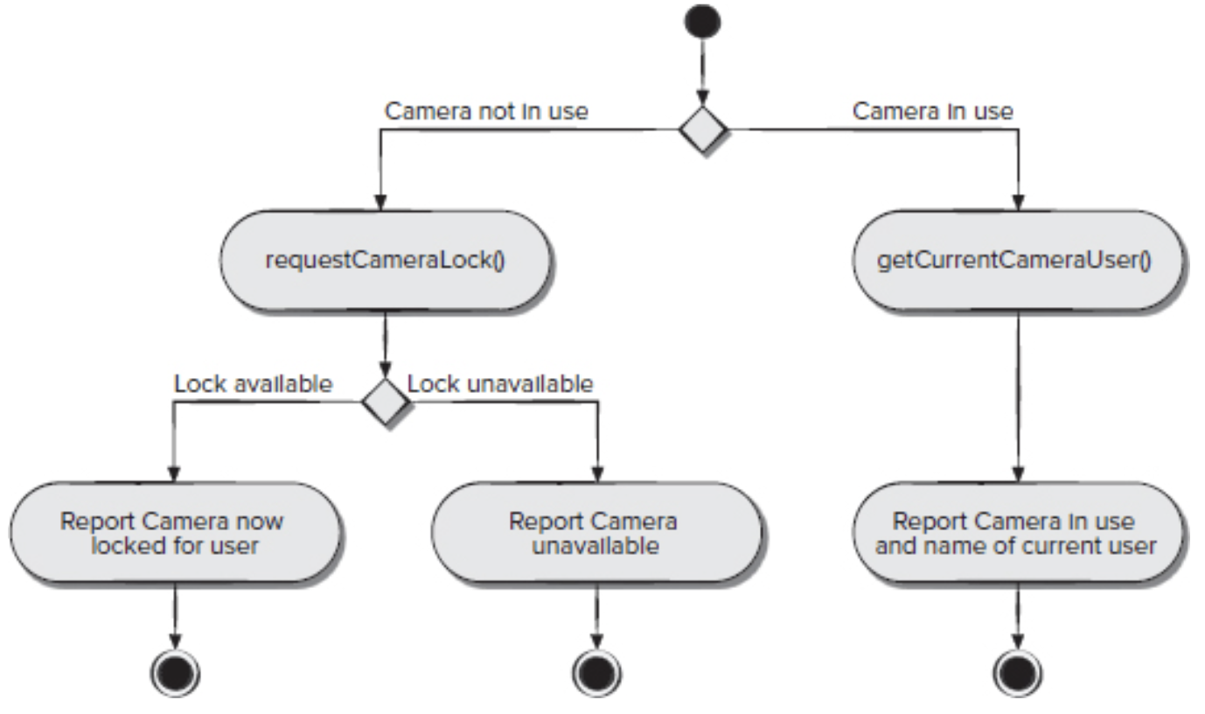
Functional Modeling
A Procedural View
Example: takeControlOfCamera() operation
What the diagram shows
Start and end of processing
Decision: camera in use or not
Conditional logic:
  Request camera lock
  Handle lock availability
  Report current camera user if locked
Supporting operations
requestCameraLock()
getCurrentCameraUser()
What is intentionally excluded
Communication protocols
Interface details
Implementation logic

Slide 37
Functional Modeling
UML Sequence Diagrams
Purpose of sequence diagrams
Used for behavioral modeling
Show how events trigger interactions between objects over time
Derived directly from use cases
What a sequence diagram represents
Objects involved in a scenario
Events/messages exchanged between objects
Order of interactions as time progresses
A sequence diagram is a behavioral view of a use case.

Slide 38
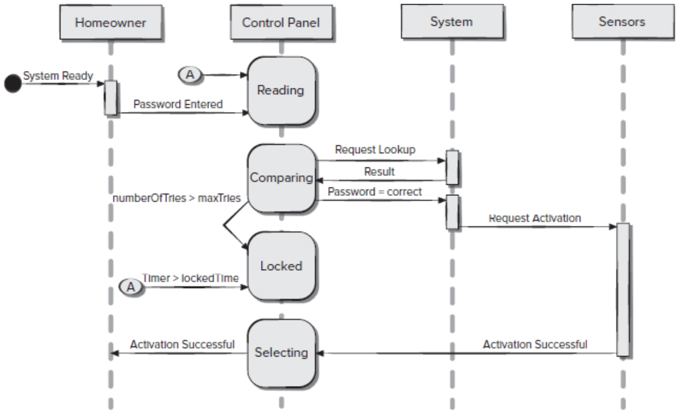
Functional Modeling
UML Sequence Diagrams
How to read the diagram
Vertical axis: time flows downward
Horizontal axis: objects / classes
Arrows: events or messages
Narrow vertical rectangles: processing activity
States may appear along the timeline
SafeHome example (partial)
External event: system ready
Homeowner enters password
Control panel requests password lookup
System validates password
Sensors are activated
Success is reported back to the homeowner
Modeling focus
Shows how behavior flows between objects
Omits:
  Implementation details
  Database structure
  Communication protocols

Slide 39
Behavioral Modeling
What behavioral modeling describes
How software responds to events or stimuli
Focuses on system behavior over time
Useful for validating system logic before design
UML diagrams used
Activity diagrams → response to internal events
State diagrams → response to external events
How the behavioral model is created
Review all use cases to understand interaction sequences
Identify events that drive system behavior
Define event sequences for each use case
Build state diagrams for the system
Review the model for accuracy and consistency

Slide 40
Behavioral Modeling
Identifying Events from Use Cases
What is an event?
An event occurs when an actor and the system exchange information
The event is the exchange itself, not the data value
How to identify events
Examine use cases for points of interaction
Look for moments where:
  An actor sends information to the system
  The system responds or changes behavior
Example: SafeHome security use case
Homeowner enters password → event: password entered
System compares password → event: password compared
Results of comparison affect control flow
Important distinctions
Some events trigger control flow changes
Others only provide information
Events are assigned to responsible objects:
  Actors may generate events
  System objects may recognize events

Slide 41
Behavioral Modeling
UML State Diagrams
What a state diagram models
How an object changes state in response to events
Focuses on behavior over time
Two views of state
Passive state
  Current values of object attributes
Active state
  The object’s current mode of operation
  Indicates ongoing processing or activity
State transitions
Triggered by events
Events cause objects to move from one active state to another
State diagrams describe the life history of an object.

Slide 42
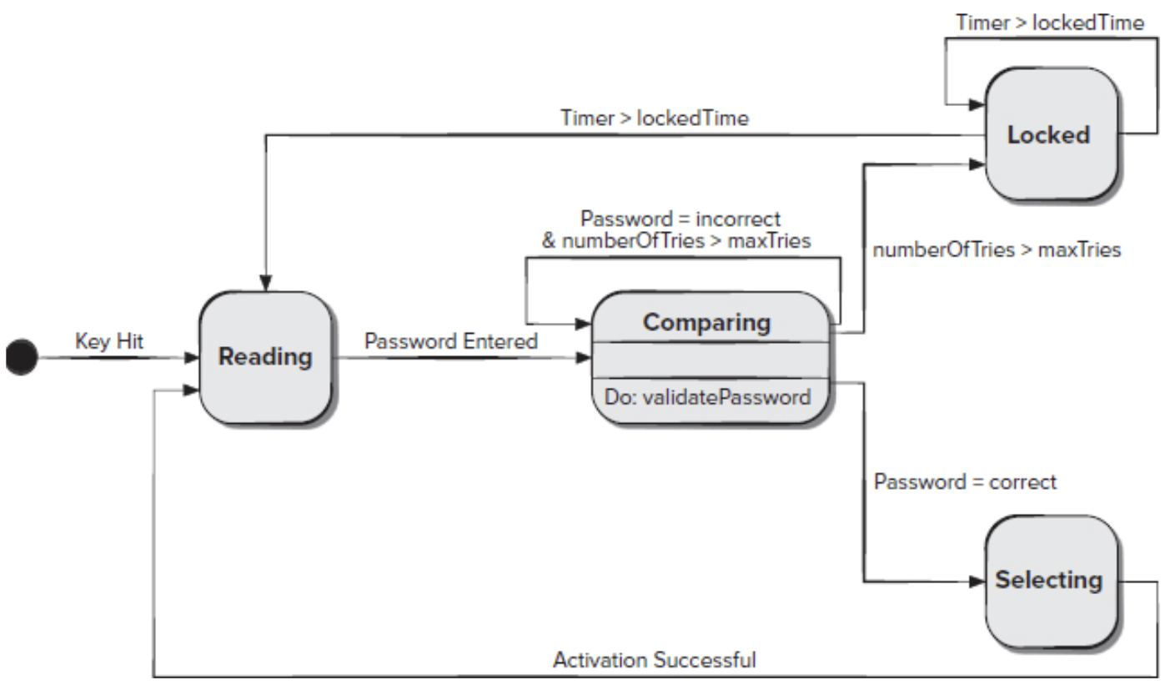
Behavioral Modeling
UML State Diagrams
Example: ControlPanel class (SafeHome)
What the diagram shows
Active states: Reading, Comparing, Locked and Selecting
Transitions between states driven by events
Transition elements
Event (trigger)
  e.g., password entered
Guard condition
  Boolean expression controlling the transition
  Example: if (password input = 4 digits)
Action
  Operation executed during the transition
  Example: validatePassword()
Important modeling rule
Guards depend on attribute values (passive state)
Actions invoke class operations

Slide 43
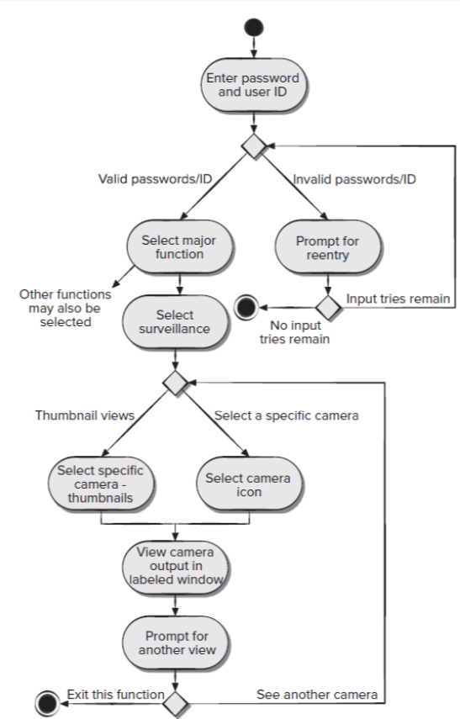
Behavioral Modeling
UML Activity Diagrams
Purpose of an activity diagram
Supplements a use case with a visual flow of actions
Shows how the system reacts to internal events
Highlights:
  Activities
  Decisions
  Alternative paths
Key characteristics
Rounded rectangles → activities
Diamonds → decisions
Arrows → control flow
May include details implied by the use case(e.g., limited password attempts)

Slide 44
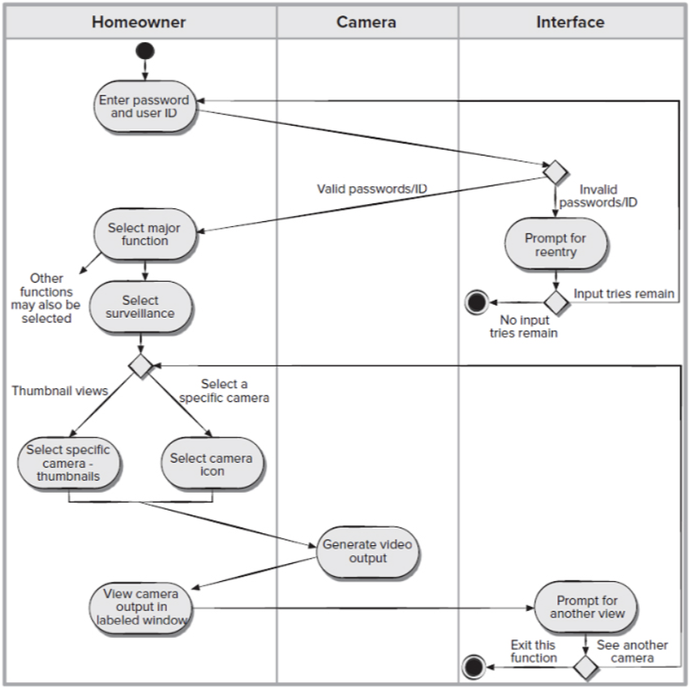
Behavioral Modeling
Swimlane Activity Diagrams
What is a swimlane diagram?
A variation of the activity diagram
Shows who is responsible for each activity
How swimlanes work
Vertical lanes represent:
  Actors, or
  Analysis classes
Activities are placed in the lane of the responsible entity
SafeHome example
Lanes represent:
  Homeowner
  Camera
  Interface
Interface responsibilities include:
  Prompt for reentry
  Prompt for another view
Control flows across lanes to show collaboration

Slide 45
References
Roger Pressman and Bruce Maxim. (2020). Software Engineering: A Practitioner's Approach. 9th. McGraw Hill. New York. ISBN: 978-1259872976.

